Slide 1
Python for Everybody
Utilizing DataCamp Light for interactive lessons

Slide 2

Client/Client Needs
Dr. Harold Nelson
Needs support material for introductory programming class

Slide 3
Challenges
Skill level of incoming students
Preparing students for future Saint Martin’s programming requirements
Clarifying content
Challenging enough, not too challenging

Slide 4
Process:
Generating material outlines
Using material outline to create course progression/ blueprints
Design course specs
Defining course audience
Sample lesson
Capstone exercises
Outline for course
“Sales” pitch (if we want to market the course)
Creating material
Testing
https://instructor-support.datacamp.com/courses

Slide 5
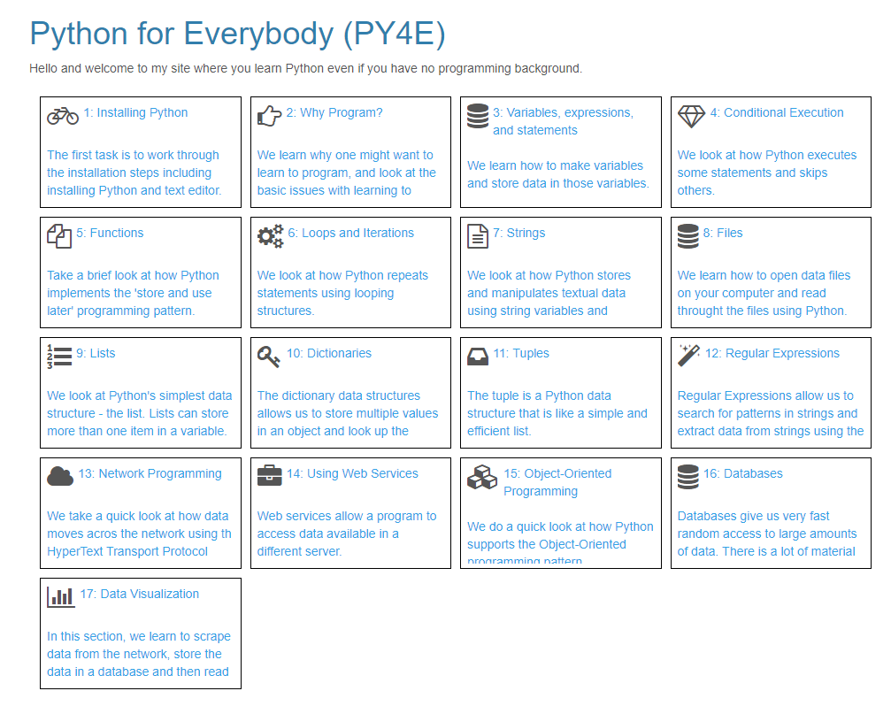

Slide 6
